Slide 1



HHS 2025-2026 Robotics Season DECODE
By Alistair Taylor, Flynn Lambley, Elijah Sutton, Miles Clark, Lilly Salter
Team 21126

Slide 2
Our Robot
Our robot uses omnidirectional wheels, which can sometimes be known as “mecanum”. With this, it allows our robot to move in many directions, enabling us to move in all degrees of motion.
If you or any other team wants to have a look at the code (written in Java), the repository on GitHub is here.
Team 21126

Slide 3
The Team
Team 21126

Slide 4
Alistair – The Programmer
I am the programmer of the robot, which has been quite a challenge to learn Java in such a short space of time!
Miles – The Team organiser
I am responsible for organising the team and their morale support.
Lilly – The builder
Description of Role
Team 21126

Slide 5
Elijah – The Input designer
Description of Role
Flynn – Output designer
Description of Role
Tom – The victim of workplace harassment
Description of Role
Team 21126

Slide 6
Programming
Alistair Taylor
Team 21126

Slide 7

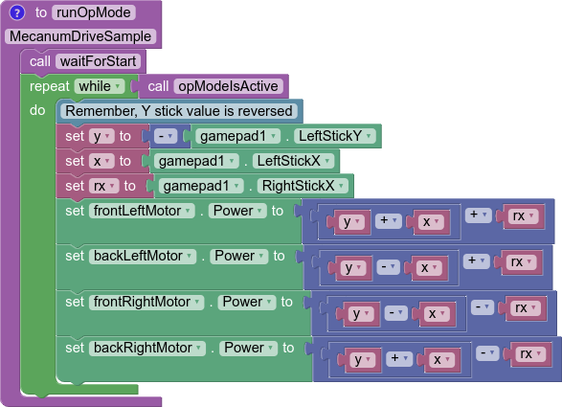

A brief overview - Drive
Our robot is split into two sections: the drive & the launcher section.
First, the drive section, the code at the side is responsible for the driving of the omni directional robot.
Confusingly, the BackLeft motor is reversed.

Slide 8
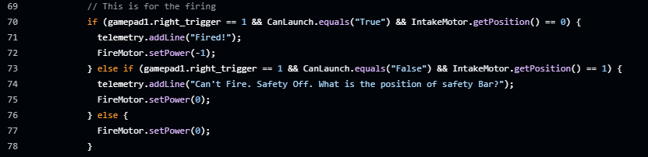

A brief overview - Launcher
Our robot is split into two sections: the drive & the launcher section.
Secondly, the launcher.
This code is responsible for activating the firing motor when a trigger is pressed and turning it off if not.

